Slide 1

Module 3 – SMA-X Service Catalog
Jan 2018
Notes:
[STANDARD SLIDE: L300 (animated)]
You can change out the photo with any image from Getty Images in DropBox.
If the main title is shorter, you can make the font larger.
You may have to move the title text around depending on the photo. Make sure the text is readable against the background photo.
You can change the background color for the rectangle in the bottom-right corner to look better against the background. Choose a Micro Focus color at 25% transparency.
=========================
Note to Narrator or Reader: [PRESS] indicates press the Page Down key to show the animation
=========================
Hello and Welcome to the [COURSE_NAME] Technical Overview Training, Level 300.
In this course you’ll gain a high-level understanding of the essentials of [PRODUCT_NAME].
[PRESS] If you want to download this presentation and save it on your own system, click the Tools & Help icon in the bottom-right corner of your window and select Download.
Or, if you want to access the PPT slides and speaker notes for future reference, go to the Attachments tab in your window click to download the presentation.

Slide 2
Objectives
After completing this module, you should be able to:
Describe the key features of Service Catalog
Understand the structure of the Service Catalog
Be able to describe the difference between a Support and Service Offering
Understand Fulfillment plans
Understand User Options and Default Values within an Offering
Know how to add a new Category, Service and Offering

Slide 3
Using the Service Catalog

Slide 4
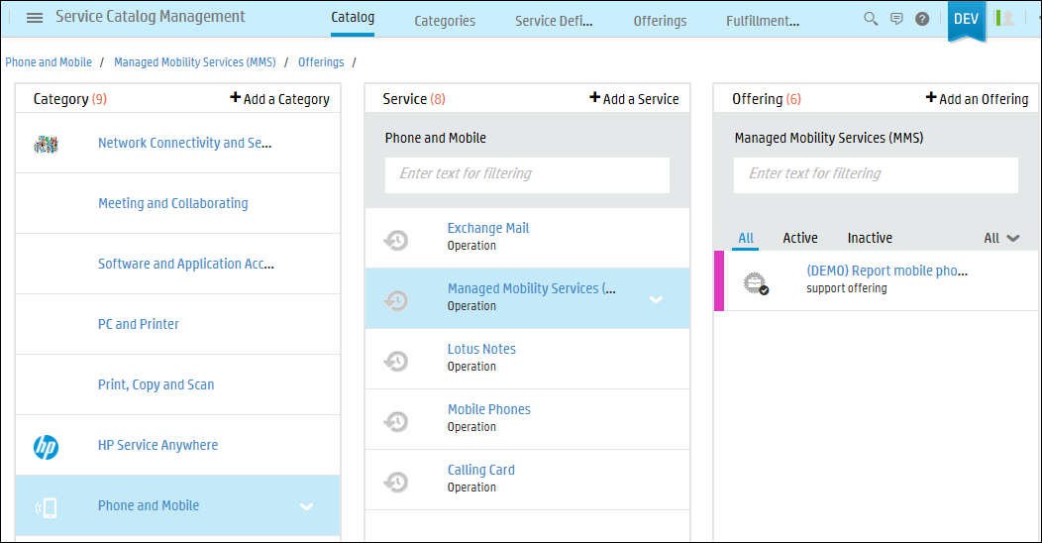
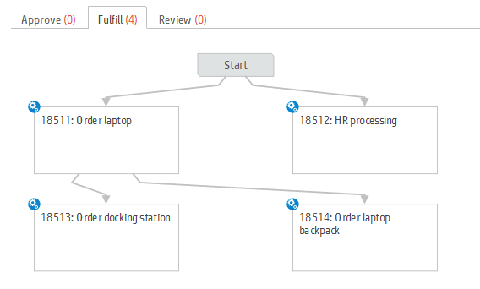
Service Catalog Features
Service Oriented
Organize and Publish Consumable Services
Define Service Offers with varying entitlements and options
Configure Service specific Support templates
Easy Publishing
WYSIWYG Publishing of Consumer Views
Dynamic Service Offering Options
Easy to configure Approval and Fulfillment Automation plans
Catalog Bundles
Reuse and group offerings into bundles
Orchestrate dependencies in the fulfillment of related items
Multilingual Catalog Support
Publish services consumed across locales
Dynamically calculated base and recurring price, multi-currency and geographical variations for the same offering
Notes:
Very easy to use and easy to administer catalog. Changing catalog categories and services and offering can be done directly from the end-user UI for WYSIWYG publishing.

Slide 5
Service Catalog features Smart Shopping and Automated Fulfillment
Catalog Management
Shopping
Fulfillment
Tracking
Measurement
Smart search
Dynamic Options
Request on Behalf
Task management
Automation plans
Cart Request and Line Item levels
Post fulfillment surveys
Service Level Targets
Email tracking and updating
Pricing
Entitlements
Fulfillment and Approval Planning
Dynamic Options
Default Values
Bundling
Request Level approval
Line Item approval
Process integration
Shopping cart
Proactive solutions
Smart Email based requesting
Bundle and line item level tracking
Up to date workflow status of each request

Slide 6
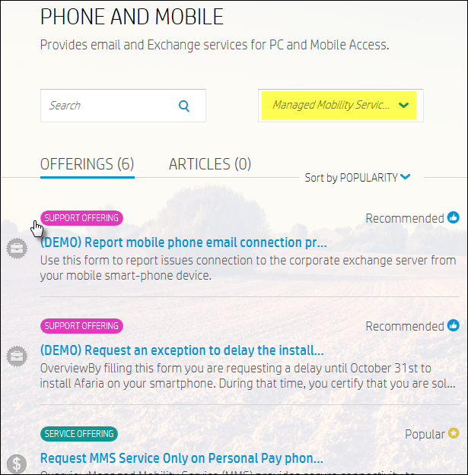
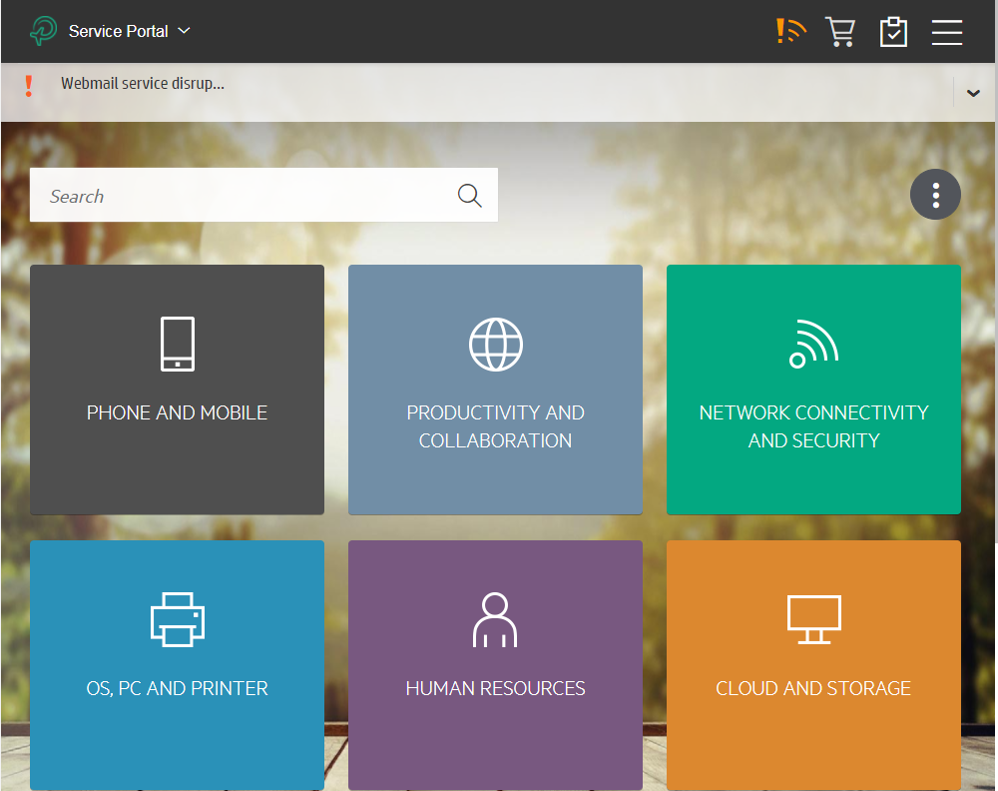
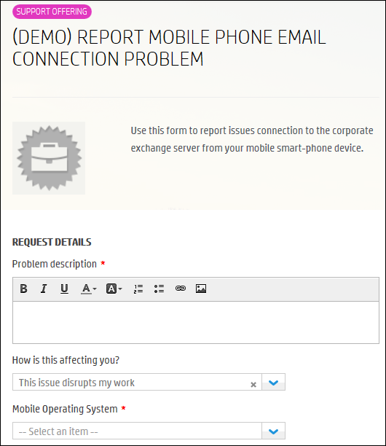
Using the Service Catalog (Self-Service)
The Service Catalog contains services offered to End Users, arranged by category.
The services are further divided into service offerings and support offerings.
Services
Offering
Categories
Offerings
Notes:
The content in the Service Catalog is displayed on the home page of the Self-Service Portal.
Offerings are also used by the Service Request agents in the Service Request Management module. When an agent opens a request, he can select an offering to channel the request directly to the correct team for handling.

Slide 7
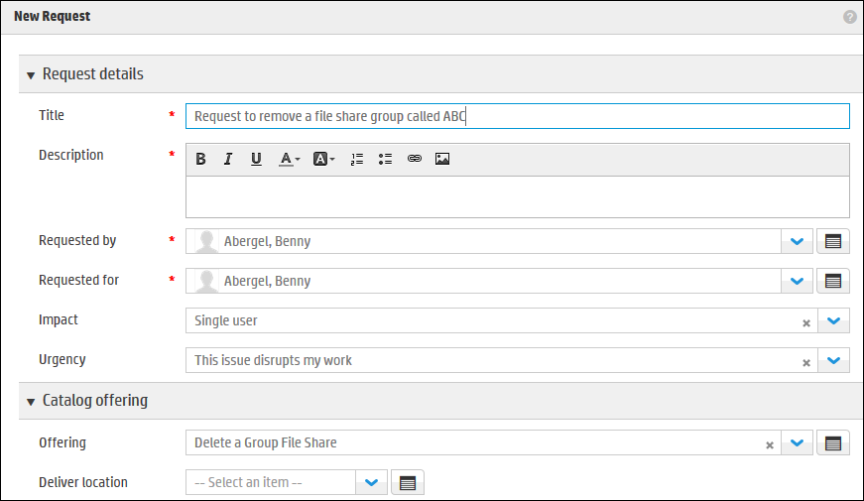
Using the Service Catalog (Agent)
Service and Support Offerings are also used by IT Agents in the Service Request module.
When an agent opens a request, the agent can select an offering to channel the request directly to the correct team for handling.
IT Agent can choose a Catalog Offering here
Notes:
The Service Catalog contains services arranged by category. The services are further divided into service offerings and support offerings.
Offerings are also used by the Service Request agents in the Service Request Management module. When an agent opens a request, he can select an offering to channel the request directly to the correct team for handling.

Slide 8
Structure of the Service Catalog

Slide 9
Service Catalog Relationship with SACM Model
Refresher from SACM module
Category
Service definition
Offering
Fulfillment plan
Actual service
Service component
System element
Device

Slide 10
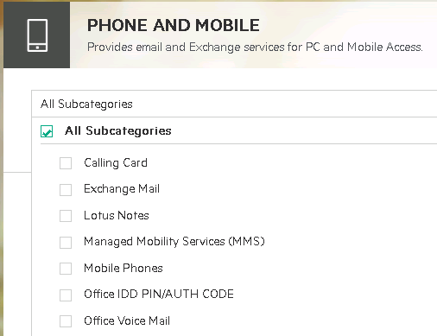

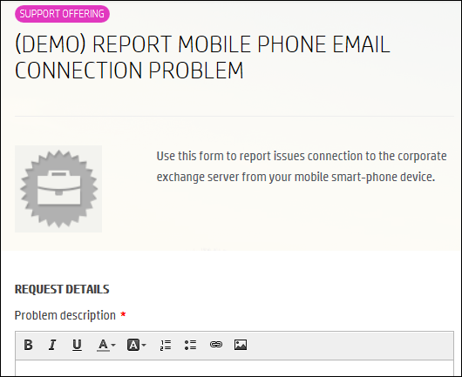
Service Catalog hierarchy
Components
Categories
Service Definitions
Offerings
Fulfillment Plans
Top Level
A category can contain services and offerings
OR a category can launch a URL
Second Level
Global description of provided services
Third Level
Service Offering with Tasks and Approvals
Support Offering with Tasks
Plus:
Audience
User options
Default values
Set up fulfillment plan to be used in offerings
Define User Options, Task Plan, Approvals & Default Values

Slide 11
Defining Service Catalog Categories and Service Definitions

Slide 12
Service Catalog Management
Service Oriented
Organize and Publish Consumable Services
Define Service Offers with varying entitlements and options
Configure Service specific Support templates
Easy Publishing
WYSIWYG Publishing of Consumer Views
Dynamic Service Offering Options
Easy to configure Approval and Fulfillment Automation plans
Integrated Fulfillment
Execute dedicated fulfillment task plans for New Service and Support fulfillment
Orchestrate automated fulfillment tasks
Offerings
Services
Categories
Notes:
Service Catalog Management is where the Service Catalog is managed. The Service Catalog contains services arranged by category.
The services are further divided into service offerings and support offerings.
The content in the Service Catalog are displayed on the home page of the Self-Service Portal.
Offerings are also used by the Service Request agents in the Service Request Management module. When an agent opens a request, he can select an offering to channel the request directly to the correct team for handling.

Slide 13
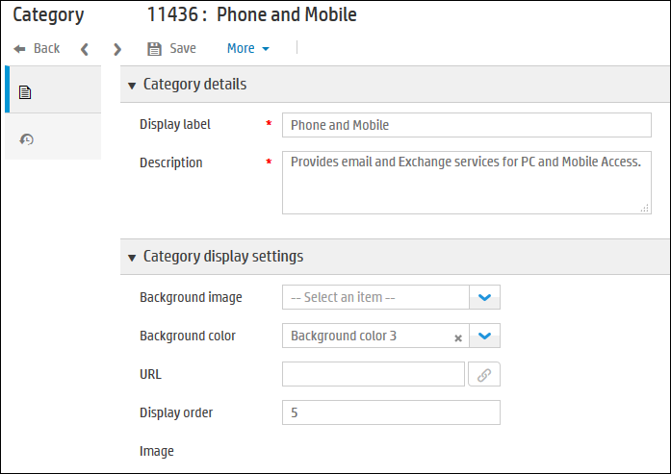
Service Catalog – Categories
Mega Menu > Service Catalog > Categories
Name of Category & Description
A Category is the highest level in the Catalog.
The category contains Services and Offerings.
OR the category can launch a URL.
Background Image for button
Background Color for button
Display order in list of Categories
Notes:
How to design category tiles for the Self-Service Portal
The category tiles on the Self-Service Portal home page can be comprised of several graphic designs. It is recommended to mix and match these designs for an interesting and attractive look. You can use available background images and solid background colors.
To access the category settings, from the main menu, select Plan > Service Catalog > Categories. There is also a link to this page at the bottom of the Self-Service Portal Settings page.
The settings are per category so you must enter each category and expand the Category display settings.
Click Save and refresh the Self-Service Portal page to view the results of your selections.

Slide 14
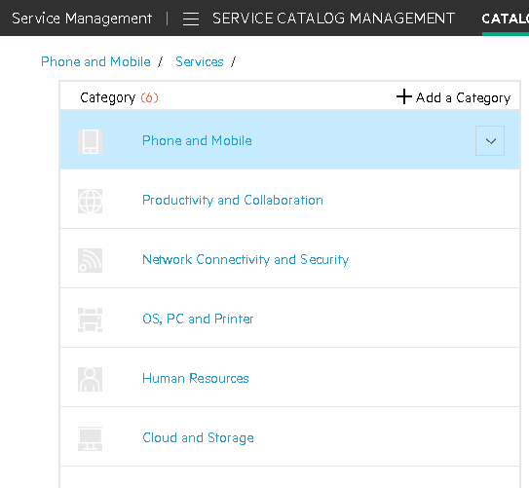
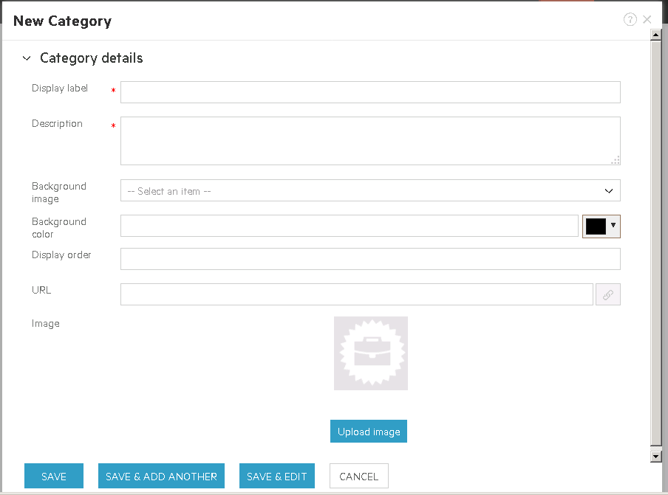
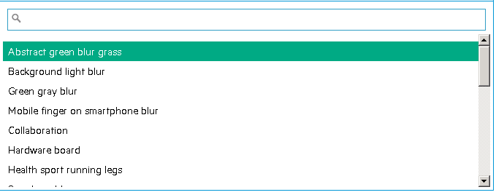
Add a Service Catalog Category
Mega Menu > Service Catalog
Sample images pack downloadable from the Service Portal Settings page provides:
28 Backgrounds
27 category icons
115 offering icons

Slide 15
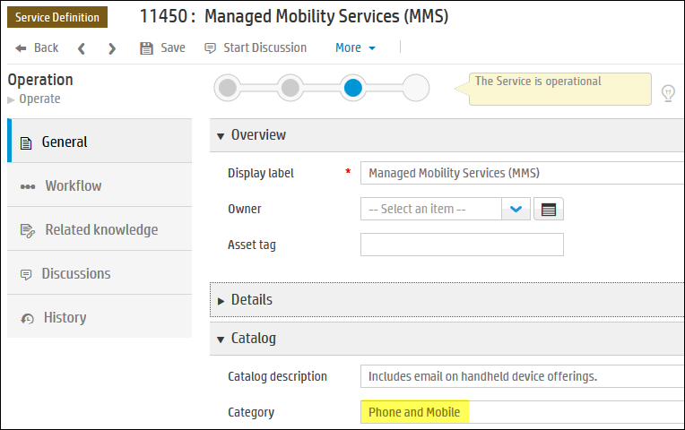
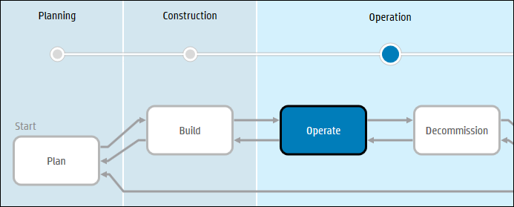
Service Catalog – Service Definitions
Name of Service Definition
Mega Menu > Service Catalog > Service Definitions
A Service Definition is a high-level description of the provided service.
In the Service Catalog, the Service (Definition) is the second level in the catalog hierarchy.
For the Service to be available, it must be in the Operate phase.
Category in Service Catalog where it is defined

Slide 16
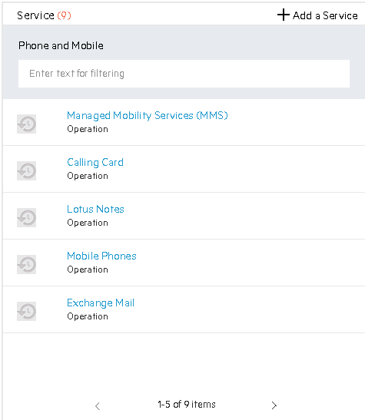
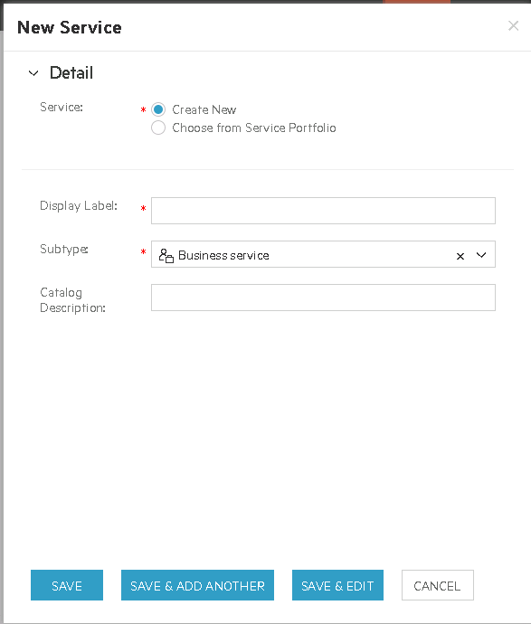
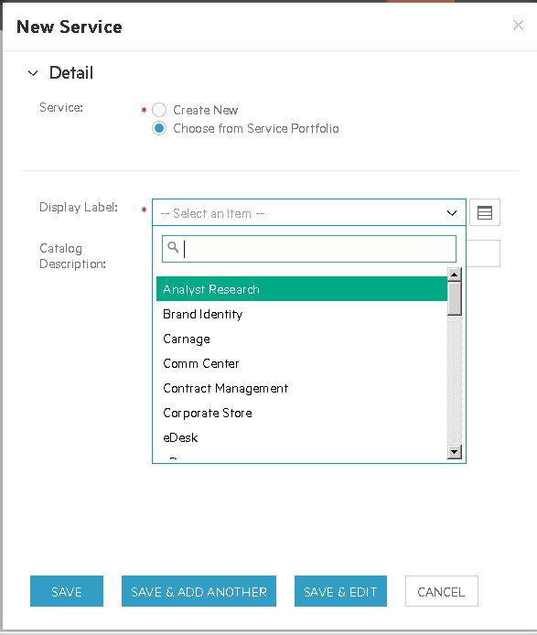
Add a Service Catalog Service Definition
Mega Menu > Service Catalog
*A new Service Definition must be moved to the Operate phase in the life cycle to be displayed .

Slide 17
Define Offerings

Slide 18
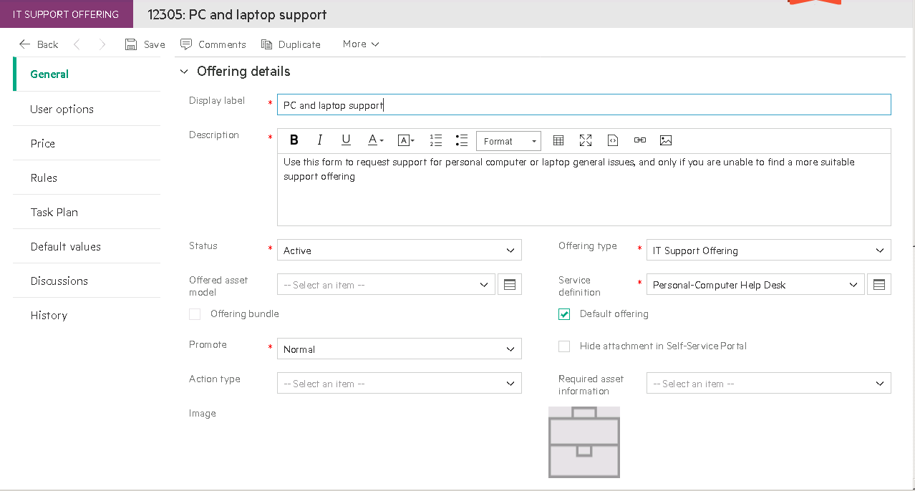
Offerings
Name of Offering
Mega Menu > Service Catalog > Offerings
An offering is either a Support or Service Offering which will log:
Support request
Service request
User Options can be set up to collect information from user.
Task plan can be set up for tasks and approvals.
For the Offering to be available, it must have status of Active.
Offering Type
Image for offering
Promote the Offering
This default offering will be used for general support requests

Slide 19
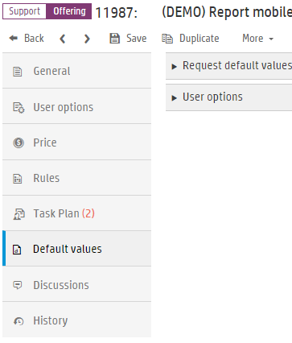
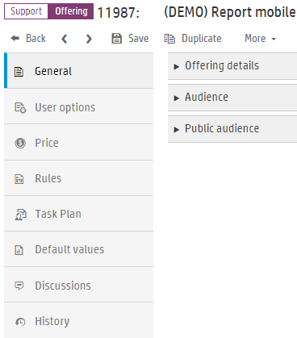
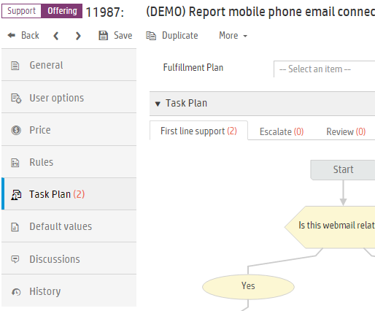
Support Offering – Record content

Slide 20
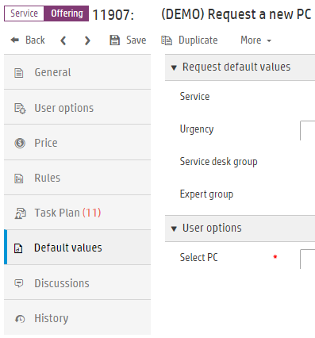
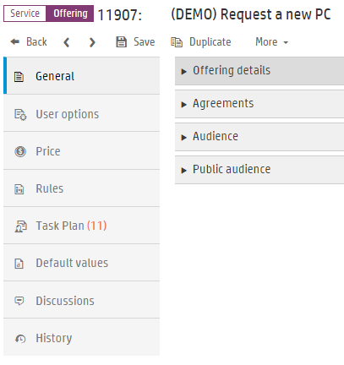
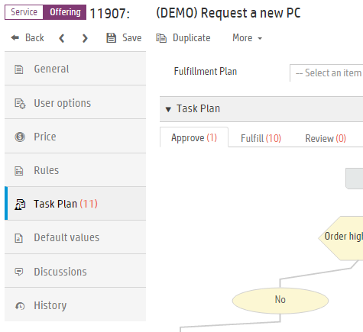
Service Offering - Record content

Slide 21
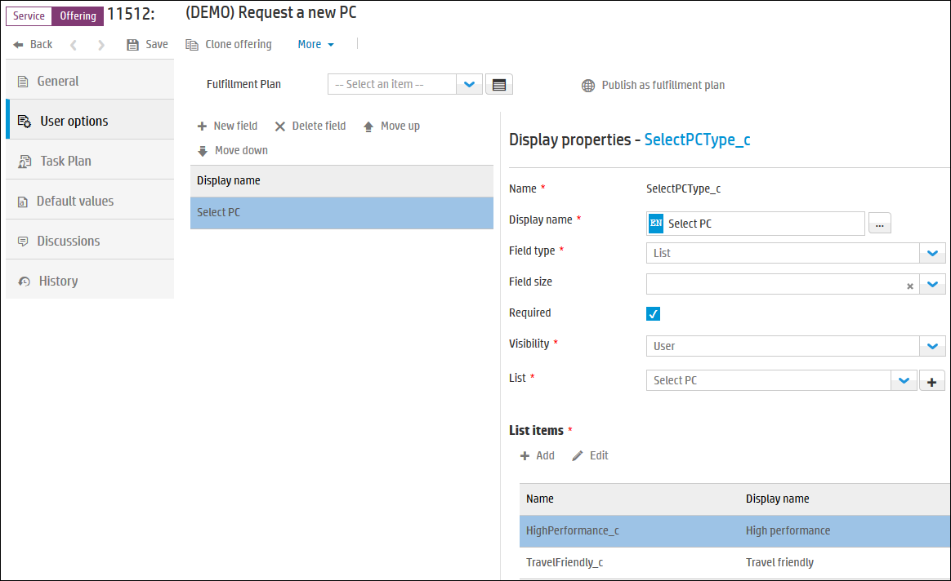
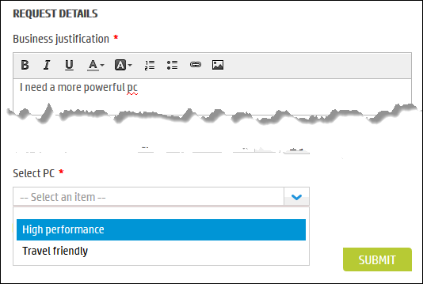
User Options
User options are specific user-defined attributes for the offering.
You can gather more information from the End User.
Unlimited number of user options on offerings.
More on configuring user options in the “How to Administer and Configure” course.
When an End User requests this offering, must Select PC from drop-down
Set as mandatory
User option Select PC is defined with choices of High performance or Travel friendly
User option Select PC is defined with choices of High performance or Travel friendly

Slide 22
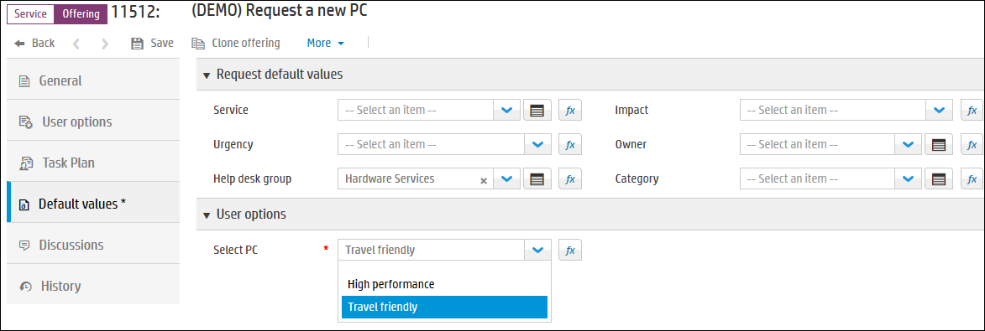
Default Values
Default Values can be set for fields in request and User options.
If you wish to set the Select PC to a value by default, set it on Default values tab.
Can set a number of request fields
Can set Select PC default value

Slide 23
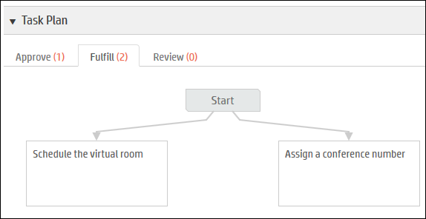
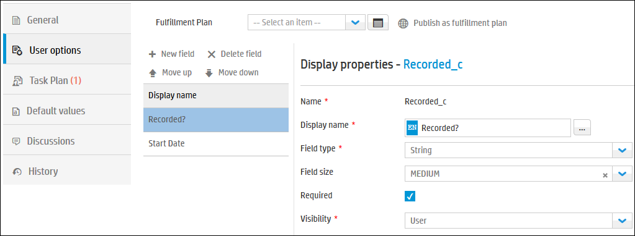
Fulfillment Plan is a reusable Approval/Task plan
Mega Menu > Service Catalog > Fulfillment Plans
Two tasks are scheduled and one approval
A fulfillment plan determines what needs to be done so that a request for an offering can be fulfilled. It can contain:
User Options
Task Plan including Approvals
Default Values
Set up the fulfillment plan once, and use it in multiple offerings.
Could be published as a Fulfillment Plan
Can set Default Values for many fields or User options
Two User options are defined to capture more information

Slide 24
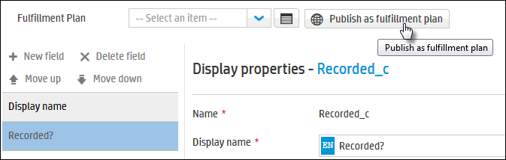
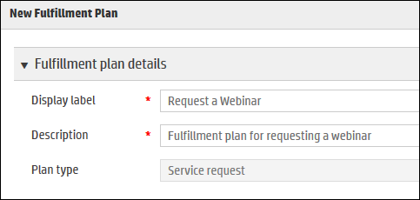
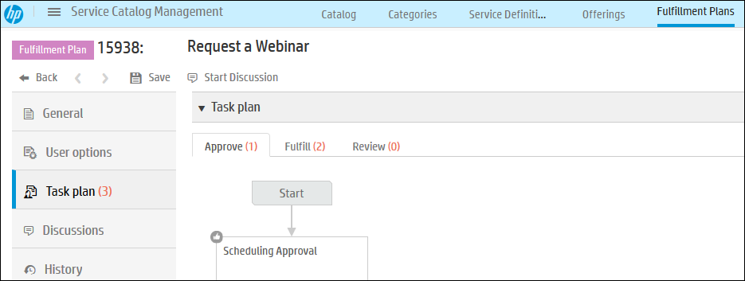
Fulfillment Plan
Mega Menu > Service Catalog > Fulfillment Plans
1. Click Publish as fulfilment plan
3. Fulfilment plan will be published to be used by other offerings
2. Fill in details and Save

Slide 25
Service Request: Governance Approvals
Records > Request > Approval definitions
Governance Approval applied to entire request which may contain one or more items
Governance Approvals are defined at the Record level, not at the Approval Plans level.
Governance approval executes as a gate before each individual offering goes to its own approval and fulfillment
Example:
Paul Walker requests 3 iPad Air 2 and 2 Samsung Galaxy S6 to do the testing on real devices.
The total price of Paul’s request exceeds $2000.00, which is the threshold of his cost center.
Paul’s request needs the approval from the cost center manager.
Total price exceeds threshold?
Cost center manager approval
YES
End
NO
Notes:
Governance Approvals are defined at the Record level, not at the Approval Plans level

Slide 26
Bundles

Slide 27
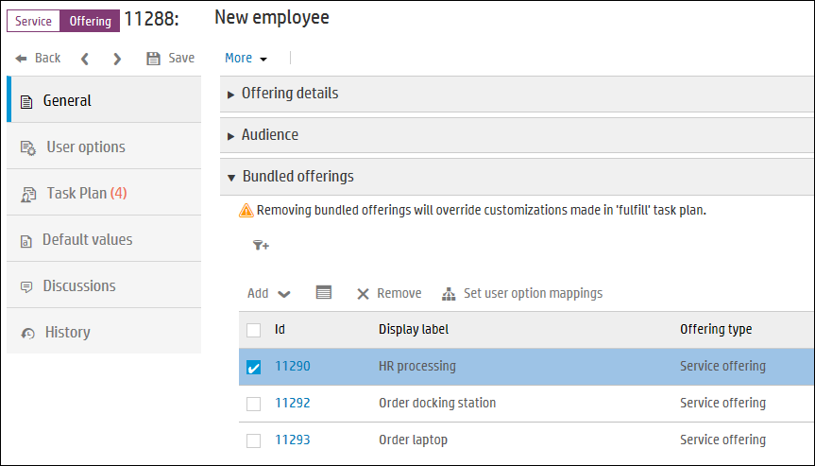
Service Catalog Bundles
A bundle is a group offering for a single request of various bundled components.
When a user requests a bundle, a parent request is created to track the total fulfilment, with individual child requests created and tracked for handling each of the bundle components.
Eg. New employee bundle:
HR processing
Order docking station
Order laptop

Slide 28
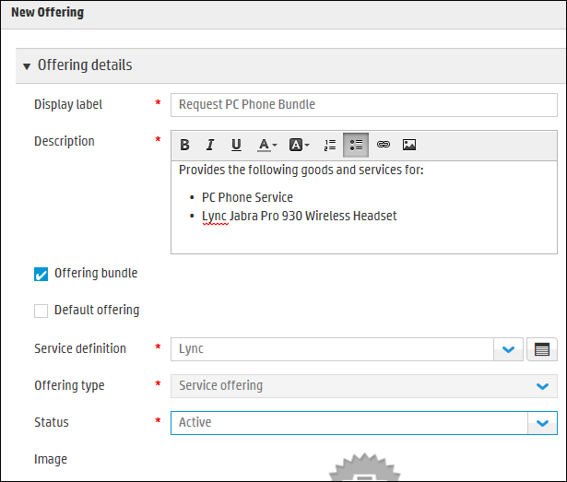
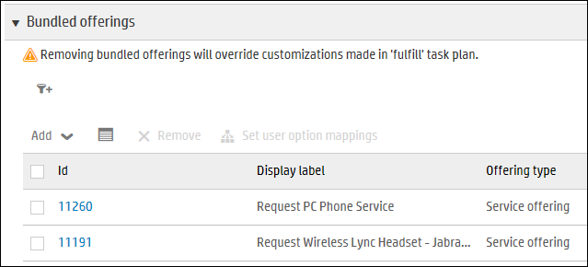
Adding a Bundle Offering
Mega Menu > Service Catalog > Offerings
Eg. Request PC Phone Bundle:
Request PC Phone Service
Request Wireless Lync Headset

Slide 29
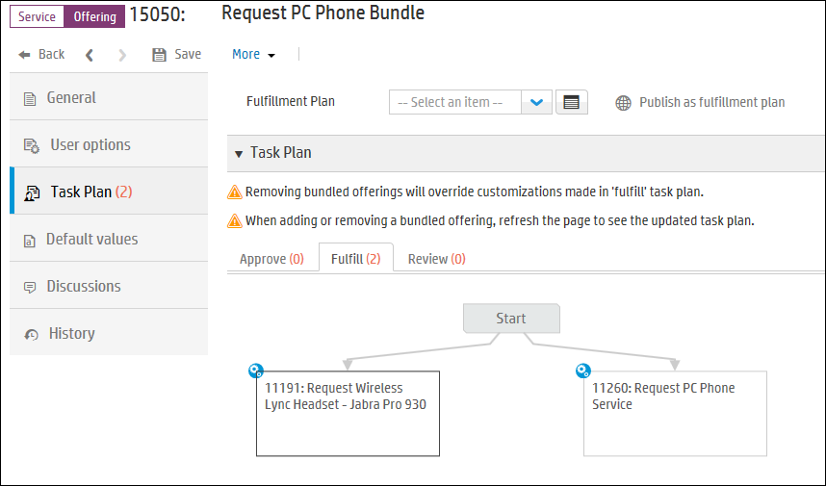
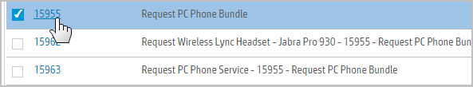
Adding a Bundle Offering
Mega Menu > Service Catalog > Offerings
An task is automatically created on the Fulfill tab to create the child service requests.
1 Parent request for bundle with multiple Child requests

Slide 30
Other features

Slide 31
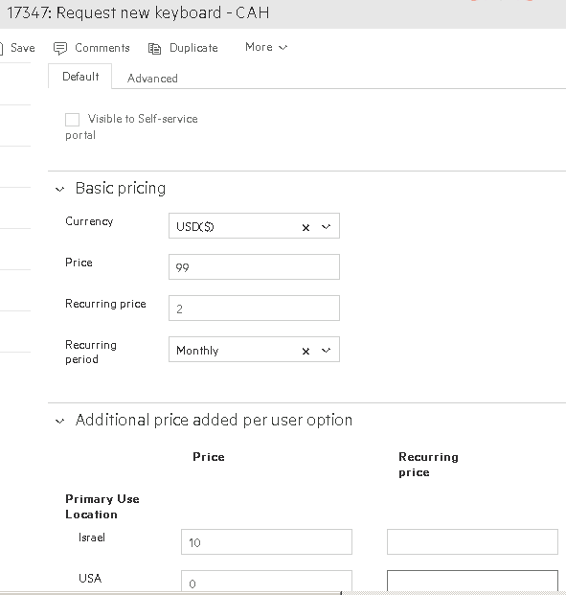
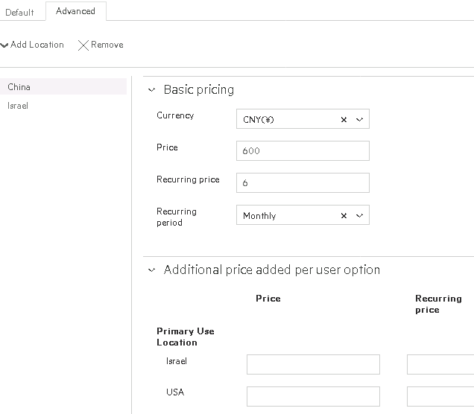
Catalog Pricing
Offering Pricing
Base price documents one time charge
Recurring price documents on-going charges per recurring time period
Catalog manager can determine whether to show price to the ESS requester or only to the approver
Context based Variations
Price can vary according to location
Variations can account for different currency based priced definitions
Option based Variations
Offering options can incur additional cost
Total price dynamically calculated based on option selection
Notes:
Pricing is defined in two parts – base price and recurring (or ongoing) support
For recurring pricing the admin has the option of defining the period weekly, monthly, annual.
We also support context sensitive variations – for example Price can vary according to location (and in the future, will be extended to organization)
Finally with pricing we have the capability to build variations based on options (as defined by the administrator)
So for instance the total price can change based on selected options and we will see an example of this in the next slides

Slide 32
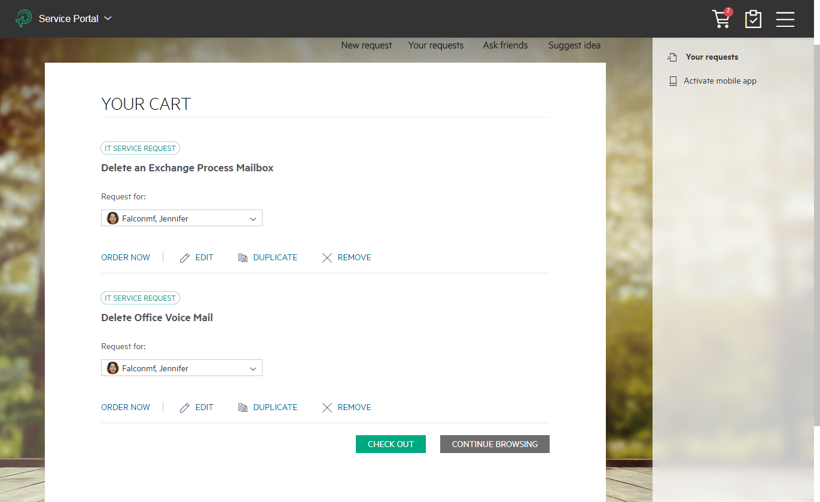
Advanced Catalog Requesting
Advanced Requesting
Shopping Cart feature allows users to group multiple items in one request
Request on Behalf mode allows authorized users to shop for others, while taking account of offering entitlement rules
Detailed Tracking
Bundle tracking provides visibility of bundle contents and their fulfillment status
Cart tracking provides visibility of global and line item level approvals and fulfillment progress

Slide 33
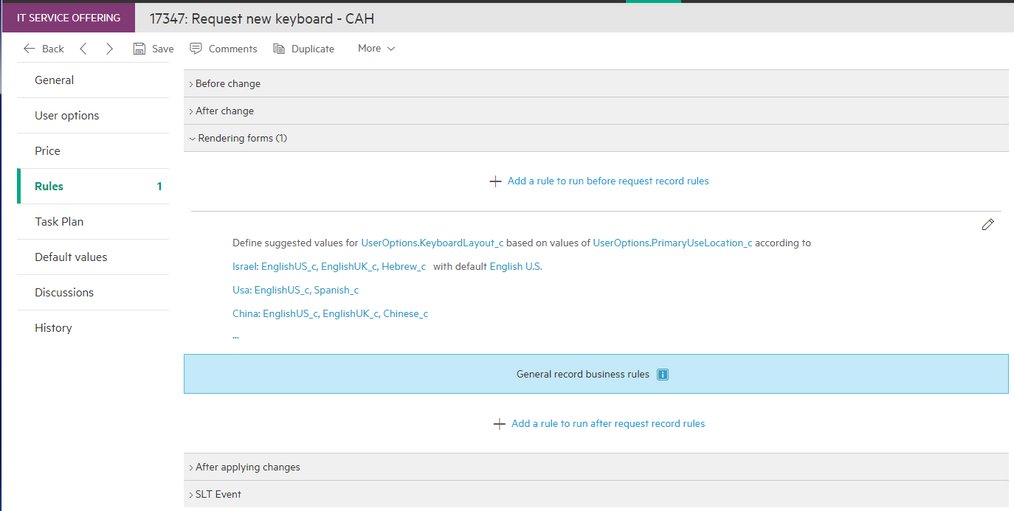
Offering Business Rules / Advanced User Options
Offering Level Business Rules
Add BR actions to a Request process based on the associated Offering
Advanced User Options
Leverage Offering BRs to control User Options
Dynamically Show/Hide options based on conditions
Validate User Option values

Slide 34
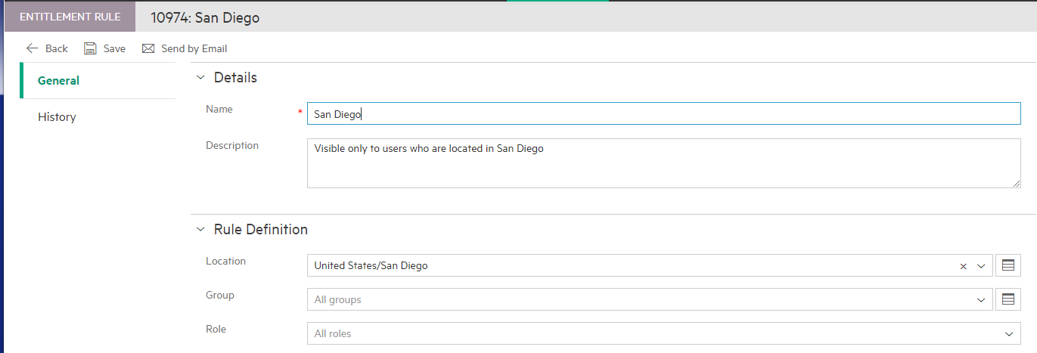
Service Catalog Audience – Content Visibility
Mega Menu > Administration > People > Entitlement Rules
Catalog Offerings can be restricted to some users via Entitlement Rules.
An Entitlement Rule can be limited to people in Locations, Groups, and/or Roles.
Entitlement Rules can be used for the Audience for Categories, Service Definitions, Catalog Offerings, Articles, News and Themes.

Slide 35


Lab Exercises
Service Request and Catalog demo card

